Slide 1
Strengthening HIV-RELATED Community organizations: evidence from a large-scale program in india
Presenter:
Madhusudana Battala
Senior Program Officer
HIV and AIDS Program
Dr. Madhusudana Battala
Dr. Sangram Kishor Patel
Ms. Monika Walia
Dr. Saradiya Mukherjee
Dr. Yamini Atmavilas
Dr. Bidhubhusan Mahapatra
Dr. Niranjan Saggurti
22nd International AIDS conference, Amsterdam, the Netherlands
23-27 July 2018

Slide 2
Journey of Avahan program (2003-17)
Started as a scaled-up HIV prevention program across 6 high prevalence states of India
Phase 1: 2003-2008
BMGF launched Avahan in 2003 with targeted HIV prevention services
Govt. of India signs MoU
Commits funding
Transition planning initiated
Phase 2: 2009-2013
Community mobilization; Community organization (CO) mentoring
Govt. signs MoU for transition timeframe
Transition completed
Indicators holding steady
Phase 3: 2014-2017
Transfer ownership to communities & address vulnerabilities through CO institutional building for sustained epidemic impact

Slide 3
Avahan 3 program model
1
2
3
4
PILLARS
Organizational development
Financial security
Social protection
Crisis
response
AIM
Improve governance, program and financial management
Enhance financial literacy and inclusion
Enable access social welfare schemes
Create an enabling environment for key population
Sustained Safe sex behavior
CORE ACTIVITIES
Leadership training
Skill building
Periodic assessment
Resource mobilization
Advocacy and networking
Liasioning with financial institutions
Financial literacy training
Workshops on financial products
Advocacy with Government departments
Processed application through unified help desk
Legal awareness trainings
Quick rapid action team
Helpline
Para-legal services
Free legal aid

Slide 4
Key questions
How to measure community organisations (CO) strength?
What has been the progress in CO strength over time? Where did the change occur?
What program ingredients helped in change of organisational strength?

Slide 5
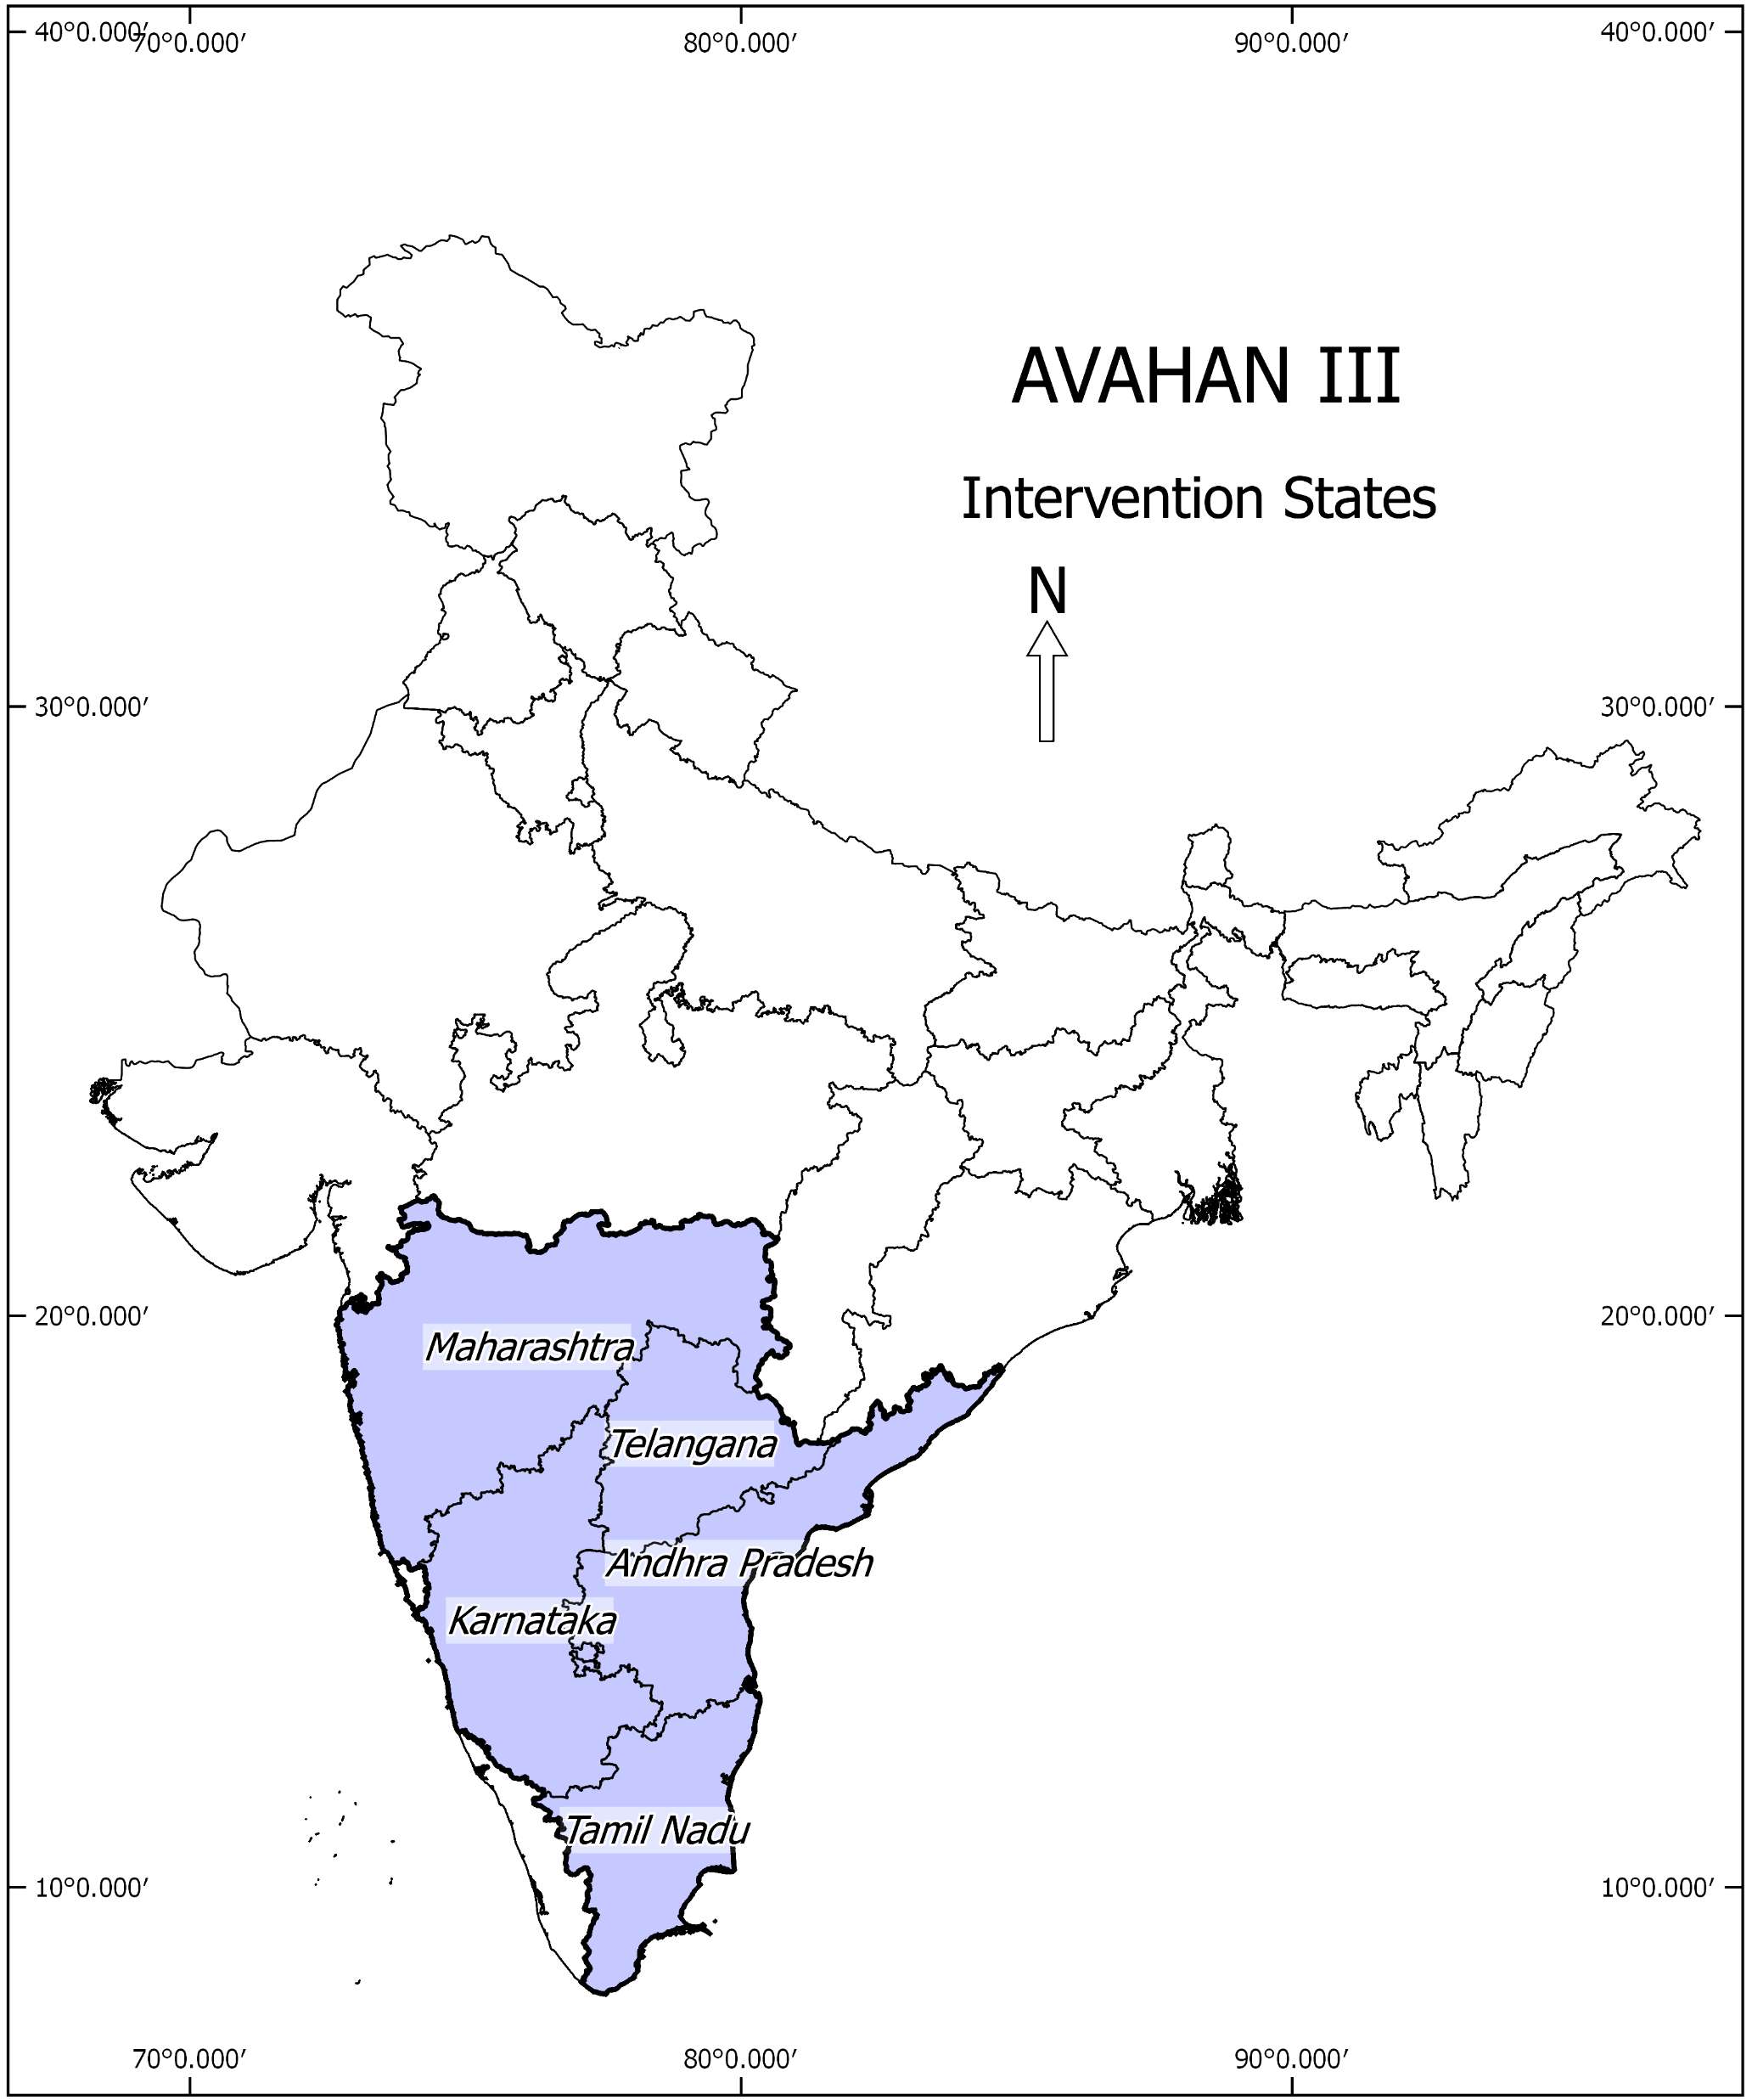
Methods
Study area: 5 states (4 southern and 1 western) of India
Data: Panel data (Baseline in 2015 and Endline in 2017) from 48 COs (out of 87 COs)
Assessment methodology: Interviews with CO leadership; Review of CO registers.
Analytical approach: Panel data analyses, decomposition analysis
Notes:
More than 1 lakh KPs were covered across 48 COs.

Slide 6
CO strength: definition & measurement
CO strength is a reflection of how COs have performed in different dimensions critical to their functionality and sustainability
CO strength measurement indicators
Multi-dimensional (6 dimensions: Governance, Project management, financial management, advocacy, resource mobilization, program monitoring)
32 indicators
Each dimensions were assigned equal weight and indicators within each dimension were assigned equal weight
Strength score was categorized into 3 categories
Foundation (<0.60): COs are functional and need more hand-holding to develop an effective program management system and implement program activities independently
Promising (0.61-0.80): Have demonstrated their capacity to implement program activities but needs time to do these activities independently.
Vibrant (0.81+): Well capacitated and Implementing program activities independently
Notes:
More than 1 lakh KPs were covered across 48 COs.

Slide 7
Change in CO strength over time
The program intervention helped a significant number of COs move from foundation to vibrant stage

Slide 8
Vibrant COs by its characteristics
Size of KP membership seems to matter the most for being vibrant COs

Slide 9
Components driving the change: Decomposition analyses
CO’s strength improved mainly due to positive change in advocacy and networking, better governance and increased resource mobilization

Slide 10
Ingredients that helped improve CO strength
Availability of seed fund at the beginning of the program
Community ownership and increased membership
Community response to organisational activities
Setting up unified help desk
Better networking and stronger advocacy
Ability to mobilize resources
Motivations of leadership

Slide 11
Change in CO strength vs actual resources
With the improvement in CO strength, the amount of corpus fund also increased. Stronger COs were having more corpus than the weaker ones at the end of 2017.

Slide 12
Income generating activities undertaken by COs
US$ 3,604 were generated (on average) through these income generating activities in the last 3 years.
- 71% COs generated funds from sources other than program funding (46% in 2015).
Notes:
Average income generation by COs?????

Slide 13
Implications
Intervention to strengthen key population led COs showed significant improvement in their strength, providing alternative to NGO structure for sustaining HIV risk reduction in countries with concentrated epidemic.
Although most COs were at Vibrant stage in end-line (with significant improvement from the levels in baseline), the ability to generate more funds to sustain the organization is critical to their sustainability.
Going forward, COs need further nurturing around fund mobilization (beyond the HIV prevention activities) to make organisations more sustainable.

Slide 14
For more information on this presentation, please write to:
mbattala@popcouncil.org

